Slide 1
WEEK 1: The Role of Publishing
Goals
Discuss course
What is “publication”?

Slide 2
I always add an appropriate cartoon with link here.

Slide 3
Lecture: Course Basics
Syllabus
Course Design
  Discussion (D2L)
  Assignment (D2L)
  Wrap-Up Discussion (in-class)
  Brief Lecture (in-class)
  Activity (in-class)

Slide 4
Activity: Write and Discuss
INDIVIDUALLY: Think about the BEST place you could publish your work.
  What is it?
  Why is this the BEST place?
  What metrics would you use to validate the notion of “BEST”?
IN GROUPS OF 3: Discuss
  What is it?
    Journal, Cons. Bio., peer-reviewed, journals I read, community I work in – where do they publish, impact factor
  Why is this the BEST place? What metrics would you use to validate the notion of “BEST”?
    Type of jobs I want – what journals are valued by employers; target audience; impact factor; Nature, Science – coverage, news media; community-engaged research – style of journal, accessible. Senior profs decide – privilege, white, tenured, English/western

Slide 5
Activity: Write and Discuss
INDIVIDUALLY: Reflect on the BEST places shared by your group members
  Who decides what is BEST?
  Who is left out of the decision-making process?
  How might this impact individual and societal benefits from research?
IN GROUPS OF 3: DISCUSS
  Discuss

Slide 6
Regroup – WHOLE CLASS
Who decides what is BEST?
  Advisor, people in power, funding agencies, social media – what’s being spread is what becomes known as “good”, government, public – impact…audience.
    Who did it in the field first!
    Who decides process? Who decides important questions?
Who is left out of the decision-making process?
  People NOT in the ”in crowd”; people without power (sometimes, for ex, Tribes); AUTHORSHIP! Depends on awareness of less powerful colleague in the publication process; taxpayers/society get left out…open-access concerns
How might this impact individual and societal benefits from research?
  Beneficiaries are often in power; follow trend! – bucking the trend is hard; society can’t advance if great ideas/methods don’t get out.. Stifling ingenuity and exploration; funder will not let info out…

Slide 7


Lecture: Who Decides?
Indexing
  Web of Science (Thomson Reuters): “the” impact factor everyone talks about
  Scopus (Elsevier): Very common in engineering
  Many others

Slide 8
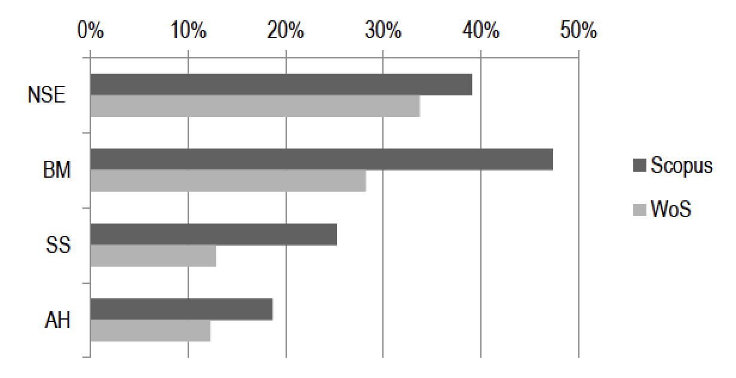
Lecture: Who Decides?
Indexing
  Web of Science (Thomson Reuters)
  Scopus (Elsevier
  Many others
% journals
Natural Science
& Engineering
Biomedical
Research
23,189 journals
14,637 journals
Social Sciences
Arts & Humanities
https://arxiv.org/abs/1511.08096
Proportion of Ulrich academic journals indexed in Web of Science and Scopus

Slide 9
Lecture: Who Decides?
Journal indexing by country
https://arxiv.org/abs/1511.08096

Slide 10

Lecture: Who Decides?
AAU
  62 US, Canada institutions
  Earn majority of competitive federal funding for academic research
  Educate, shape policy for higher education, science, and innovation
  EVERYONE wants in!
http://www.aau.edu/

Slide 11
Lecture: Who Decides?
AAU: How does an institution join?
  1. Competitively funded federal research support.
  2. Membership in the National Academies (NAS, NAE, IOM).
  3. Faculty awards, fellowships, and memberships.
  4. Citations: Thomson Reuters InCitesTM.
http://www.aau.edu/

Slide 12
Regroup – WHOLE CLASS
Put it all together: How do AAU, WoS, Scopus influence notions of “BEST”?
  Who gets left out of the conversation?
Brainstorm all of the places someone could publish their research and why!
  Blog, tweet, curriculum, white papers, website for findings, data, book, facebook, extension bulletins, comics, TV, podcasts, YouTube, NPR, open reports for federal agencies

Slide 13
WEEK 1: The Role of Publishing
Reading – on D2L is optional (so DONE!)
Discussion about course – DONE!
Lecture – DONE!
Activity – DONE!
Next Week: Identifying Journals
  Assignment: Your manuscript topic; three possible journals; at least one “no” journal

